Slide 1
University of Basrah
Al-Zahraa Medical College
Ministry of higher Education and Scientific Research
Academic year 2019-2020
3rd year S 5/6
Integrative Module
Session: 7 Lecture 2
Date:24/6/2020
The Bone Marrow and Bone Marrow Failure
Module staff:
Dr Ihsan Mardan (module leader)
Dr Jawad Ramadhan Dr Firas Rashid
Dr Miami Kadhum Dr Rehab A. Jaafer
Dr Sadiq Khalaf Dr Nehaya Alaboody Dr Hussein Katei Dr Ansam Munadhel
Dr Hadeel Salman
You can contact us on the telegram

Slide 2
University of Basrah
Al-Zahraa Medical College
Ministry of higher Education and Scientific Research
Learning Outcomes:
After this session you should be able to:
Describe the sites of haemopoiesis in the foetus, child and adult and the structure of the bone marrow.
Describe how cytopenia or pancytopenia can develop.
Describe the clinical manifestation of pancytopenia or individual cytopenia (neutropenia or thrombocytopenia).

Slide 3
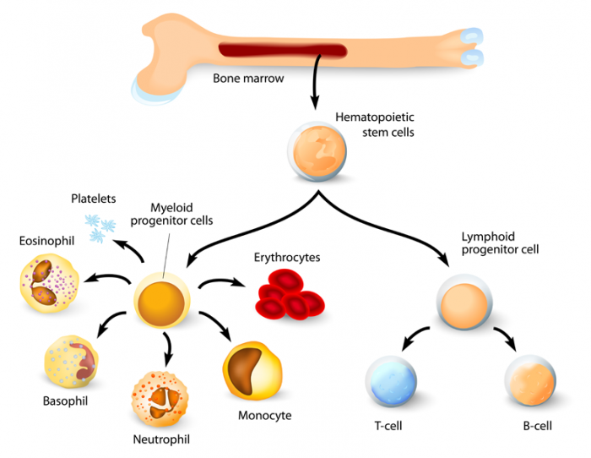
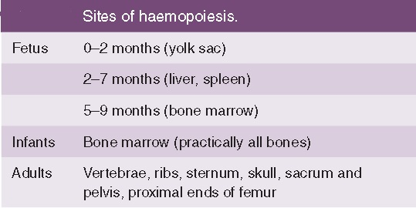
University of Basrah
Al-Zahraa Medical College
Ministry of higher Education and Scientific Research
LO 1

Slide 4
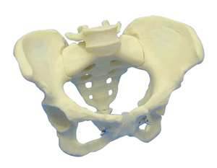
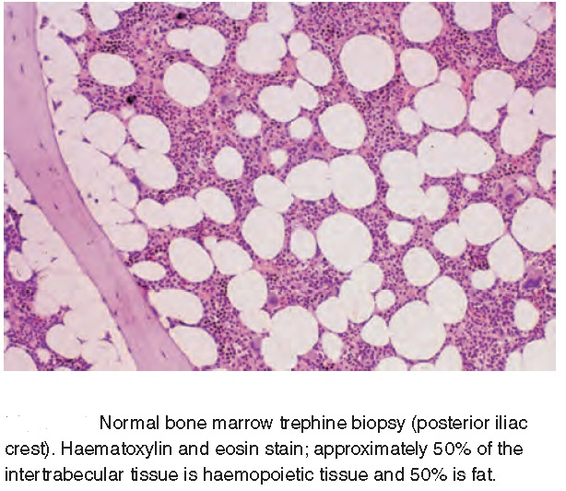
University of Basrah
Al-Zahraa Medical College
Ministry of higher Education and Scientific Research
LO 1
Bone Marrow is the soft, highly vascular and flexible connective tissue within bone cavities which serve as the primary site of new blood cell production or haematopoiesis.

Slide 5
University of Basrah
Al-Zahraa Medical College
Ministry of higher Education and Scientific Research
LO 1
The bone marrow is composed of:
cellular and non-cellular components
and structurally be divided into:
Vascular and non-vascular regions.
The non-vascular section of bone marrow is composed of haemopoietic cells of various lineages and maturity, packed between fat cells, thin bands of bony tissue (trabeculae), collagen fibres, fibroblasts and dendritic cells. This is where haematopoiesis takes place.
The vascular section contains blood vessels that supply the bone with nutrients and transport blood stem cells and formed mature blood cells away into circulation.

Slide 6
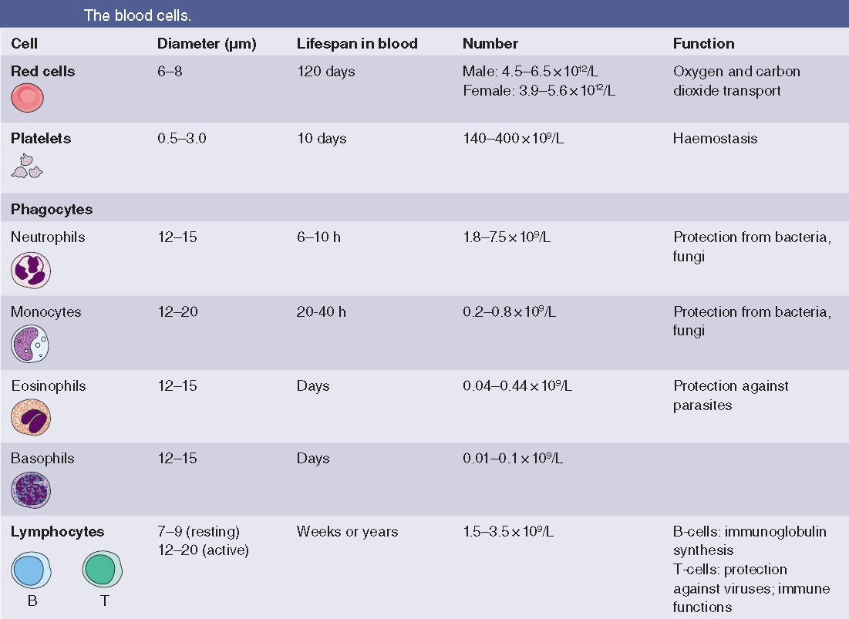
University of Basrah
Al-Zahraa Medical College
Ministry of higher Education and Scientific Research
LO 1

Slide 7
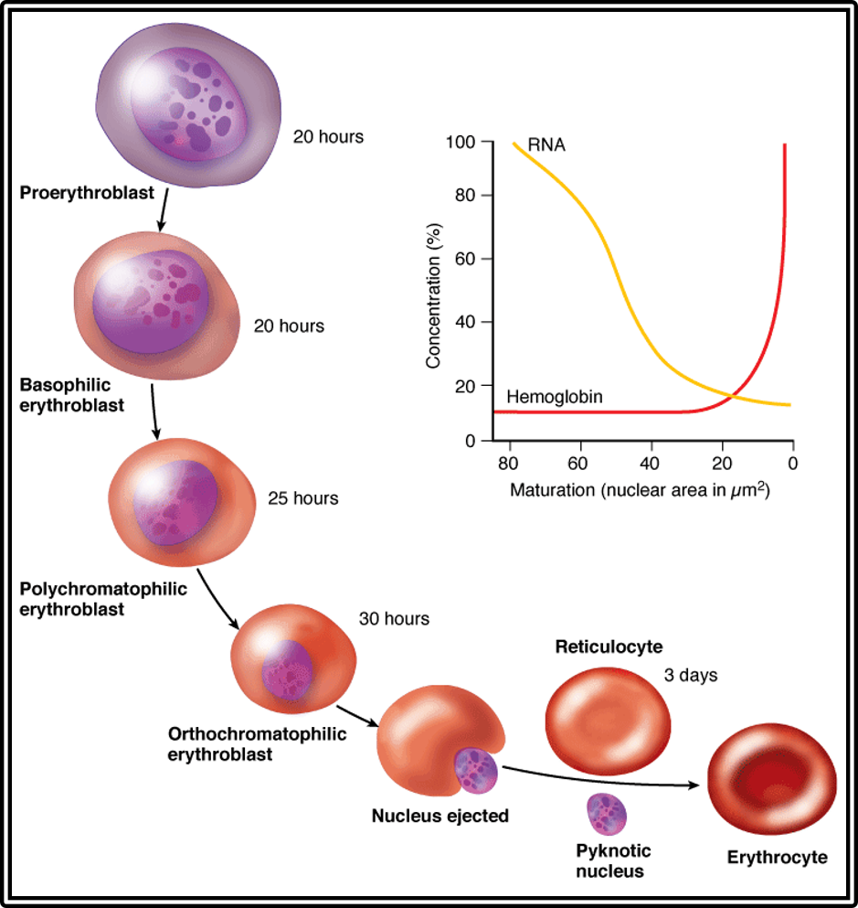
University of Basrah
Al-Zahraa Medical College
Ministry of higher Education and Scientific Research
LO 1
Erythrocyte development image (above) lifted from histonano.com

Slide 8
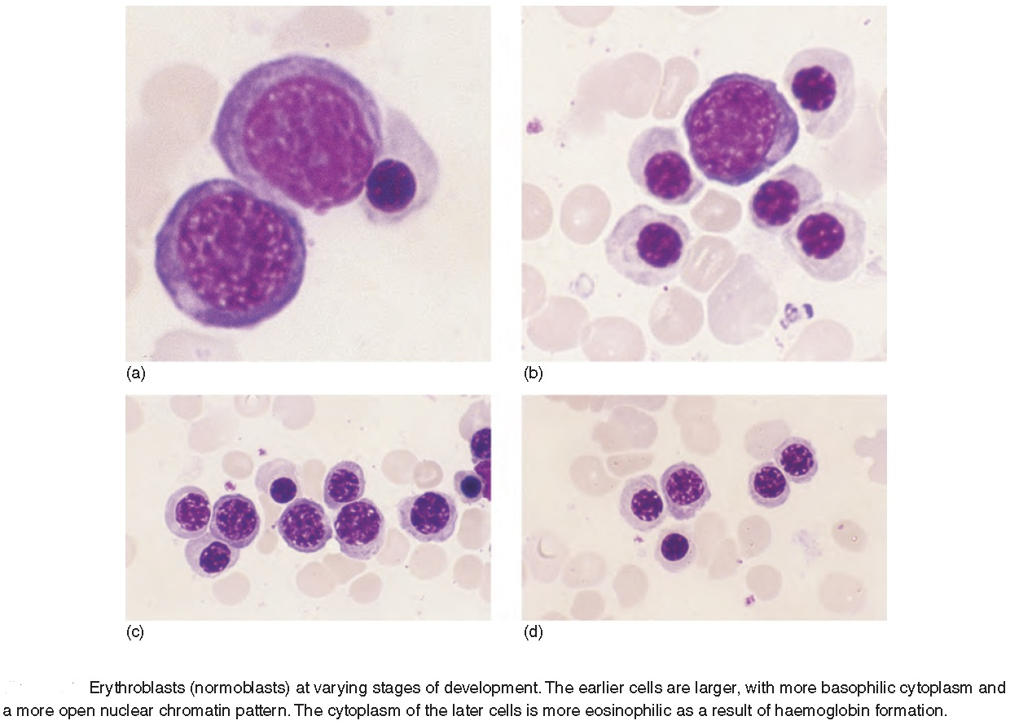
University of Basrah
Al-Zahraa Medical College
Ministry of higher Education and Scientific Research
LO 1

Slide 9
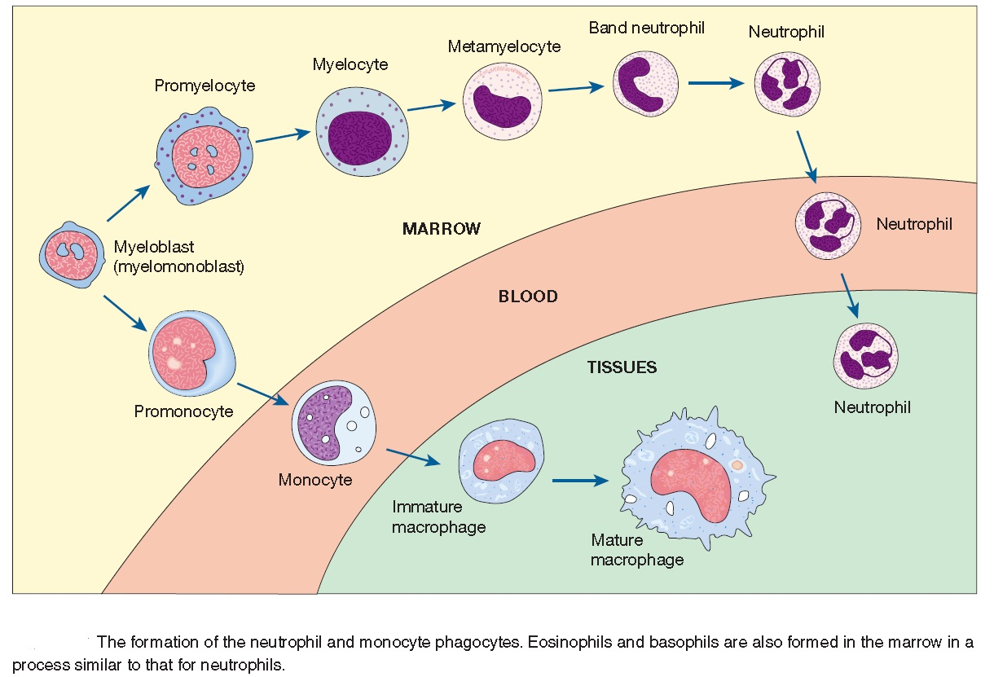
University of Basrah
Al-Zahraa Medical College
Ministry of higher Education and Scientific Research
LO 1

Slide 10
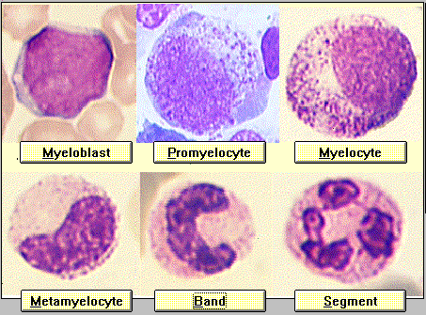
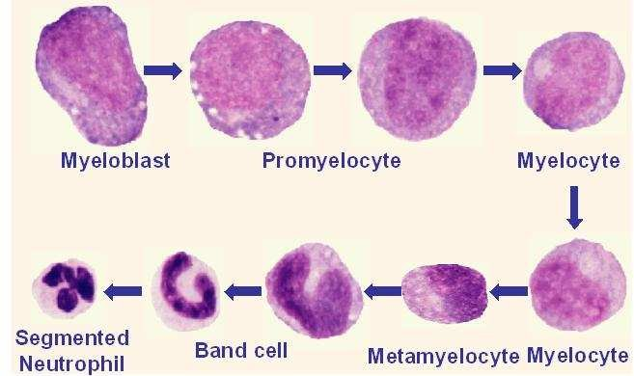
University of Basrah
Al-Zahraa Medical College
Ministry of higher Education and Scientific Research
LO 1

Slide 11
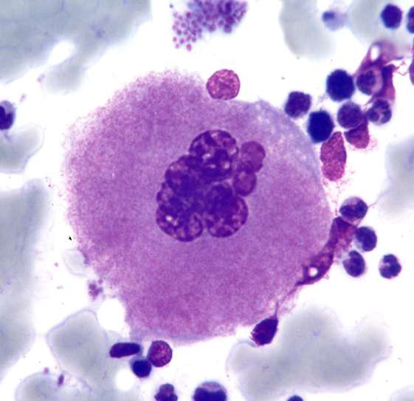
University of Basrah
Al-Zahraa Medical College
Ministry of higher Education and Scientific Research
•Megakaryocytes produce platelets
•Cells increase in size and replicates its DNA
•Platelets ‘bud’ from the cytoplasm
•Platelet production is controlled by
thrombopoietin (TPO)

Slide 12
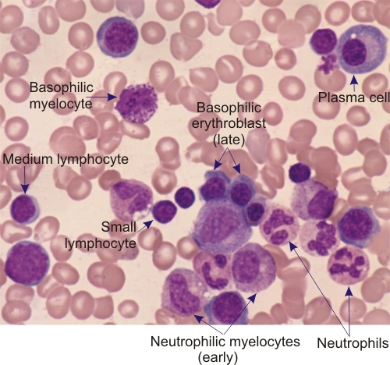
University of Basrah
Al-Zahraa Medical College
Ministry of higher Education and Scientific Research

Slide 13
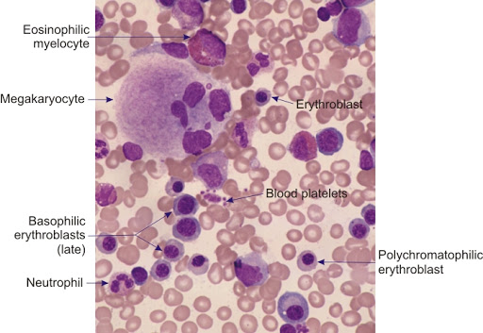
University of Basrah
Al-Zahraa Medical College
Ministry of higher Education and Scientific Research
LO 1

Slide 14
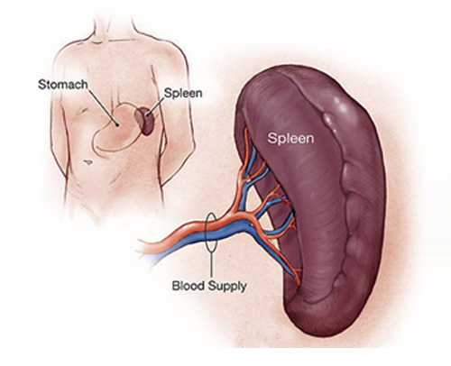
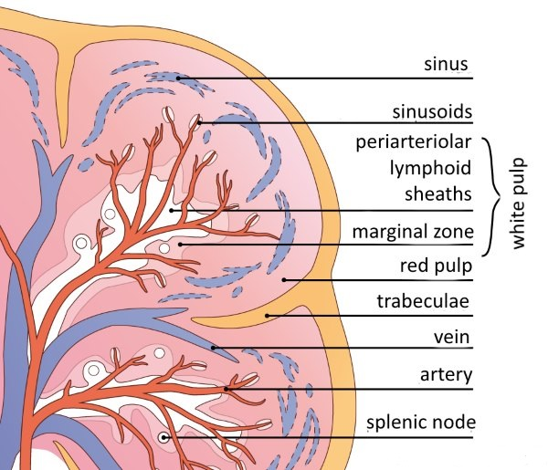
University of Basrah
Al-Zahraa Medical College
Ministry of higher Education and Scientific Research
The spleen
The spleen lies under the left costal margin, has a normal weight of 150–250 g and a length of between 5 and 13 cm. It is normally not palpable but becomes palpable when the size is increased to over 14 cm.

Slide 15
University of Basrah
Al-Zahraa Medical College
Ministry of higher Education and Scientific Research
Function of spleen
Sequestration and phagocytosis of old/abnormal red cells, removed by macrophages
Immunological function – 25% of T cells and15% of B cells are present in the spleen
Blood pooling – platelets and red cells can be rapidly mobilised during bleeding
Extramedullary haemopoiesis – pluripotential stem cells proliferate during haematological stress

Slide 16
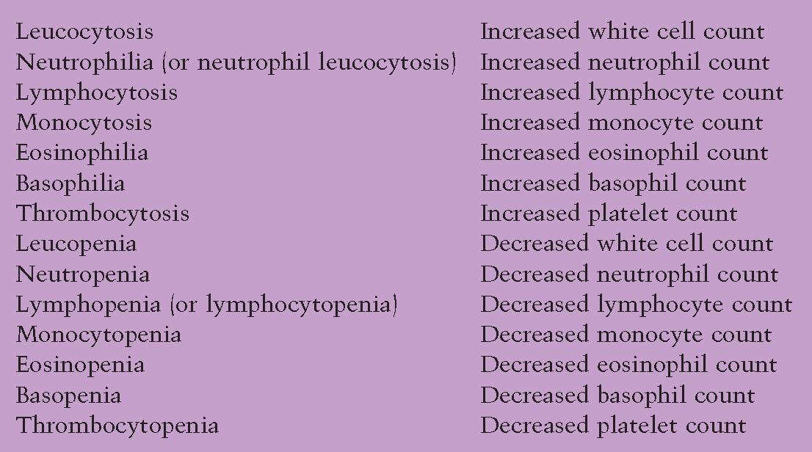
University of Basrah
Al-Zahraa Medical College
Ministry of higher Education and Scientific Research
LO 2

Slide 17
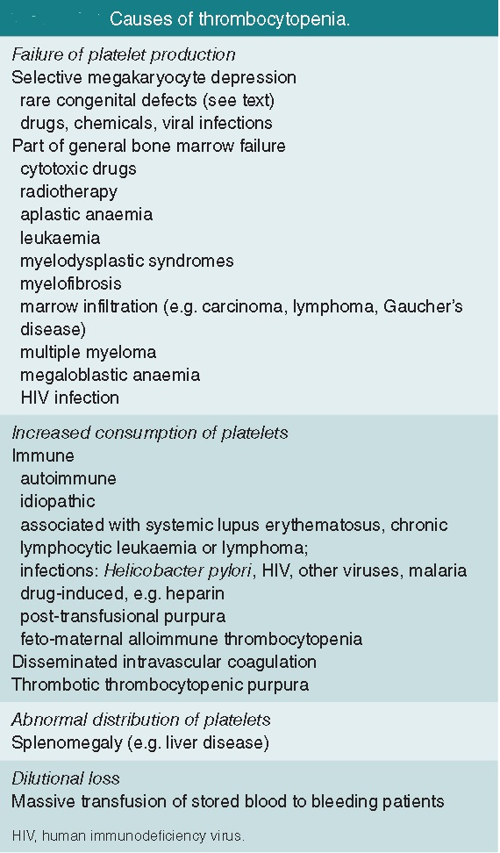
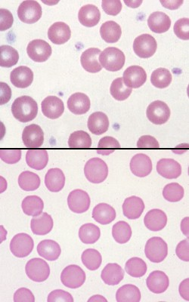
University of Basrah
Al-Zahraa Medical College
Ministry of higher Education and Scientific Research
Thrombocytopenia
LO 2

Slide 18
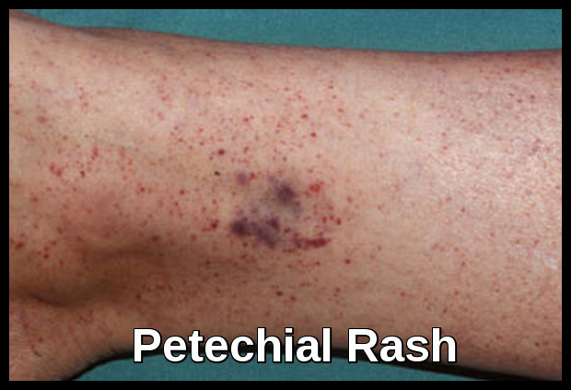
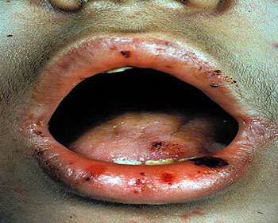
University of Basrah
Al-Zahraa Medical College
Ministry of higher Education and Scientific Research
Consequences of thrombocytopenia
Easy bruising
Petechiae, purpura
Mucosal bleeding
Severe bleeding after trauma
Intracranial haemorrhage
LO 2

Slide 19
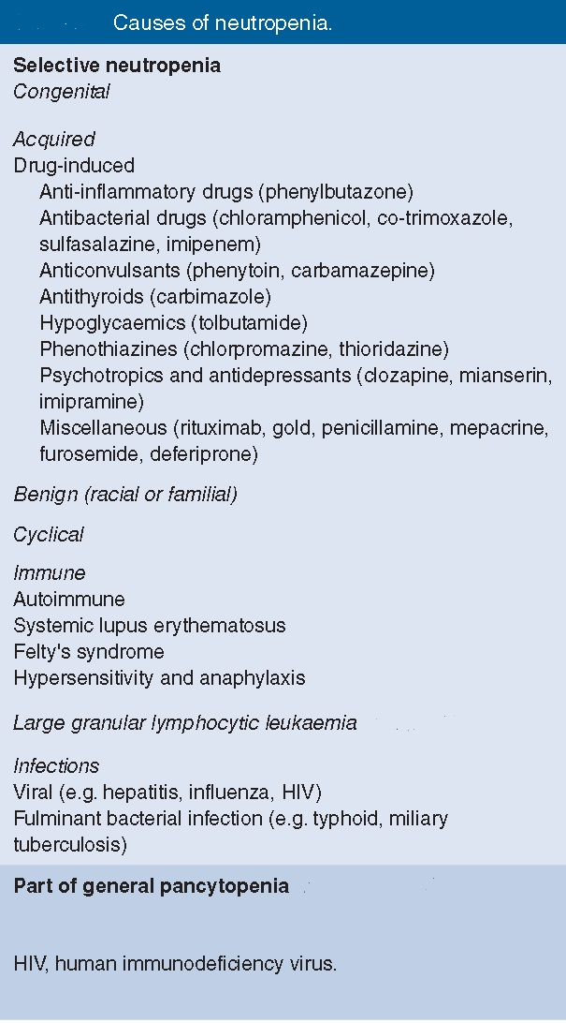
University of Basrah
Al-Zahraa Medical College
Ministry of higher Education and Scientific Research
LO 2
Neutropenia
Consequences of neutropenia
Severe life threatening bacterial infection
Severe life threatening fungal infection
Neutropenic sepsis is a medical emergency!

Slide 20
University of Basrah
Al-Zahraa Medical College
Ministry of higher Education and Scientific Research
LO 3
Pancytopenia is a reduction in the blood count of all the major cell lines red cells, white cells and platelets. It has several causes, which can be broadly divided into decreased bone marrow production or increased peripheral destruction.

Slide 21
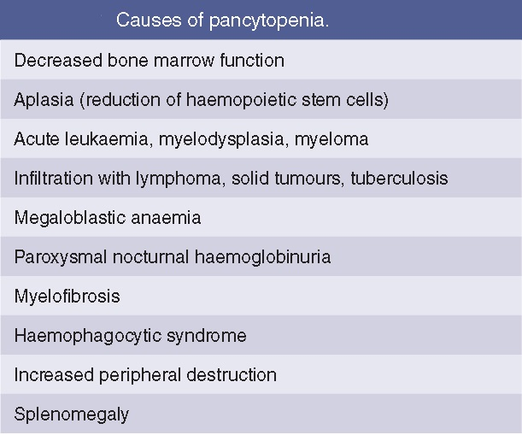
University of Basrah
Al-Zahraa Medical College
Ministry of higher Education and Scientific Research
Consequences of pancytopenia
LO 3
Symptoms of anaemia: fatigue, dizziness, chest pain, shortness of breath etc..
Symptoms of thrombocytopenia: bleeding, bruising etc...
Symptoms of neutropenia: infection, ulcers, fevers etc...
Symptoms of underlying cause

Slide 22
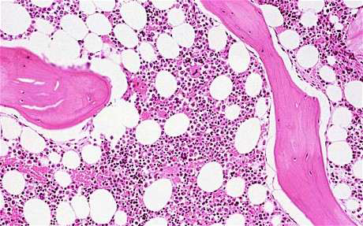
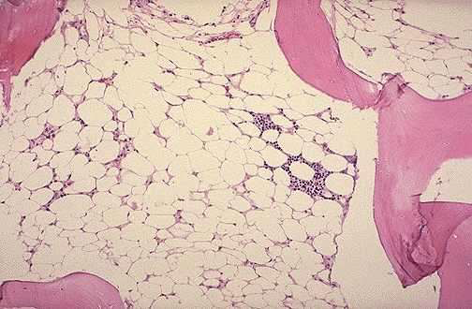
University of Basrah
Al-Zahraa Medical College
Ministry of higher Education and Scientific Research
Aplastic Anaemia
Pancytopenia with a hypocellular bone marrow in the absence of an abnormal infiltrate and with no increase in reticulin (fibrosis)

Slide 23
University of Basrah
Al-Zahraa Medical College
Ministry of higher Education and Scientific Research
Thank you for your listening

